Slide 1
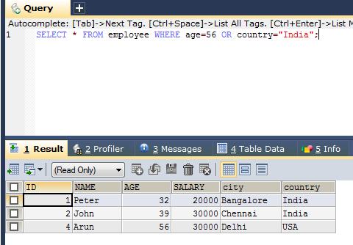
SQL OR Operator
The WHERE clause can be combined with AND, OR, and NOT operators.
The OR operator is used to filter records based on more than one condition. The OR operator displays a record if any of the conditions separated by OR is TRUE
SELECT * FROM employee WHERE age=56 OR country="India";
SELECT column1, column2, ... FROM table_name WHERE condition1 OR condition2 OR condition3 ...;

